Slide 1
Implementation of Association Rule Mining

Slide 2
Submitted by :-
Chandra Shekhar Yadav(ADTU/2018-22/BCS/010)
Nilratan Sarkar(ADTU/L/2018-22/BCS/017)
Semester :- 7th sem , Department :- B.Tech(Computer Science)
Guided by : - Ms. Eirene Barua

Slide 3
TABLE CONTENTS
INTRODUCTION................................................................................................................... 4
WHY ASSOCIATION RULES ARE USED?................................................................................ 5
HOW ASSOCIATION RULE WORK......................................................................................... 6
ALGORITHMS USED(APRIORI ALGORITHM)......................................................................... 7
IMAGE EXMPLE OF APRIORI ALGORITHM............................................................................ 8
REAL WORLD USE CASES FOR ASSOCIATION RULES............................................................. 9
TECHNOLOGIES USED(PYTHON)........................................................................................... 10-11
SOFTWARE REQUIREMENTS................................................................................................. 12
HARDWARE REQUIREMENTS................................................................................................ 13
SCREENSHOTS....................................................................................................................... 14-24
CONCLUSION......................................................................................................................... 25

Slide 4
INTRODUCTION
We will add some data , find frequent itemsets using apriori algorithm.
Mine association rules using association_rules method of mlxtend library.
Make plot of the association rules using matplotlib.pyplot for better understanding of the mined data.

Slide 5
Why Associations Rules are used?
In data mining, association rules are useful for analyzing and predicting customer behavior.
They play an important part in customer analytics, market basket analysis, product clustering, catalog design and store layout.

Slide 6
How Association Rules Work
An association rule has two parts: an antecedent and a consequent . An antecedent is an item found within the data. A consequent is an item found in combination with the antecedent.
Association rules are created by searching the dataset for frequent patterns and using the criteria support and confidence to identify the most important relationships. Support is an indication of how frequently the items appear in the data. Confidence indicates the number of times the statements are found true.

Slide 7
Algorithm Used : -
Apriori Algorithm : -
It is used for mining frequent itemsets .
It is used to operate on a database containing a lot of transactions, for instance, items brought by customers in a store.

Slide 8
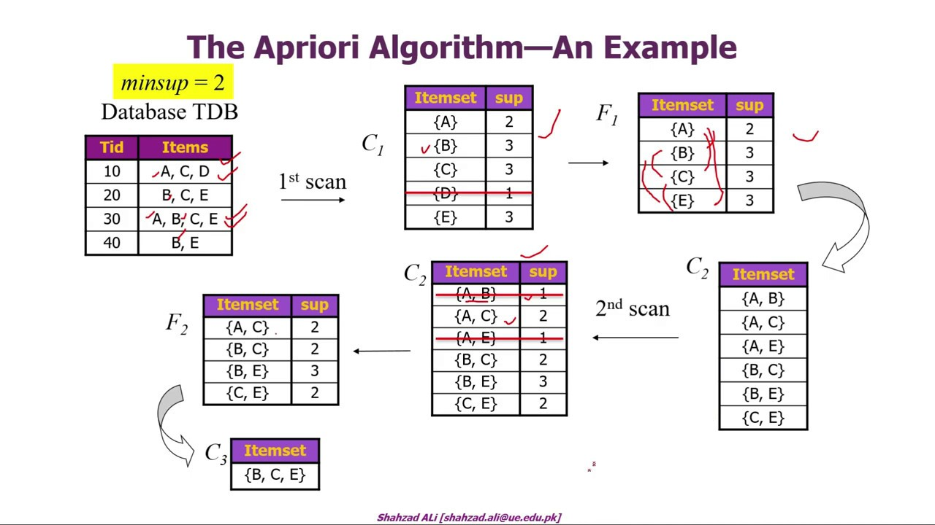

Slide 9
Below are a two real-world use cases for association rules : -
Retail : - Machine learning models can look for co-occurrence in this data to determine which products are most likely to be purchased together. The retailer can then adjust marketing and sales strategy to take advantage of this information
Entertainment : - Machine learning models analyze past user behavior data for frequent patterns, develop association rules and use those rules to recommend content that a user is likely to engage with, or organize content in a way that is likely to put the most interesting content for a given user first.

Slide 10
Technologies used : -
Python :- Python is often used to build websites and software, automate tasks, and conduct data analysis,data visualisation,AI and machine learning.
➢ Libraries used : -
Numpy : - NumPy is library in python used for working with arrays. It also has functions for working in domain of linear algebra, fourier transform, and matrices.

Slide 11
2. Pandas : - Pandas is a library in Python for data analysis and manipulation .
3. Mlxtend : - Mlxtend (machine learning extension) is a library in python of useful tools for the day-to-day data science tasks.
4. Matplotlib : - Matplotlib is a comprehensive library for creating static, animated, and interactive visualizations in Python.

Slide 12
Software Requirements : -
Anaconda Individual Edition
Anaconda aims to simplify package management and deployment.
The distribution includes data-science packages suitable for Windows, Linux, and macOS.

Slide 13
Hardware Requirements : -
2 CPU cores
2GB Ram or Higher.
20 GB HDD or Higher.
Free space required 1.5GB .

Slide 14
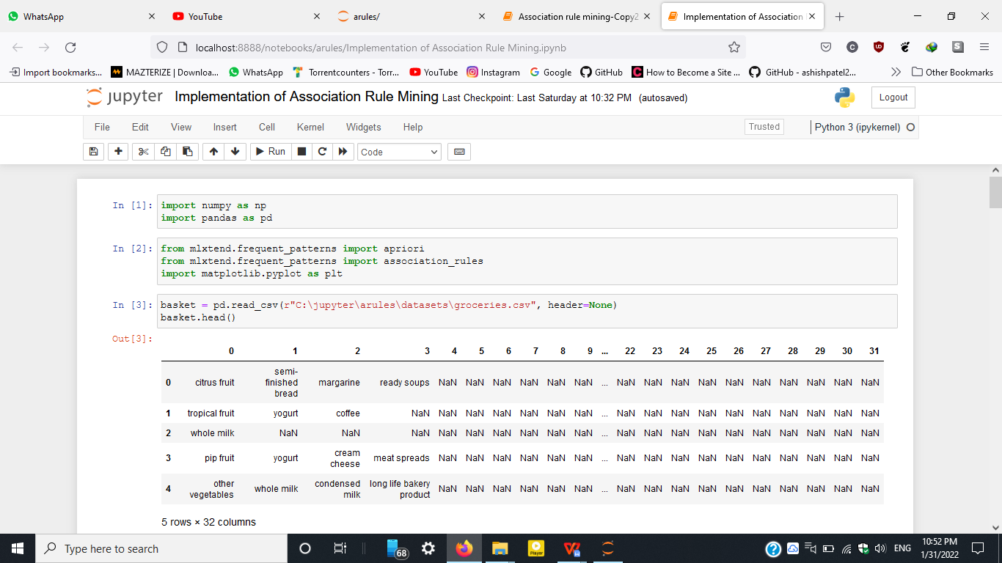
Screenshots : -

Slide 15
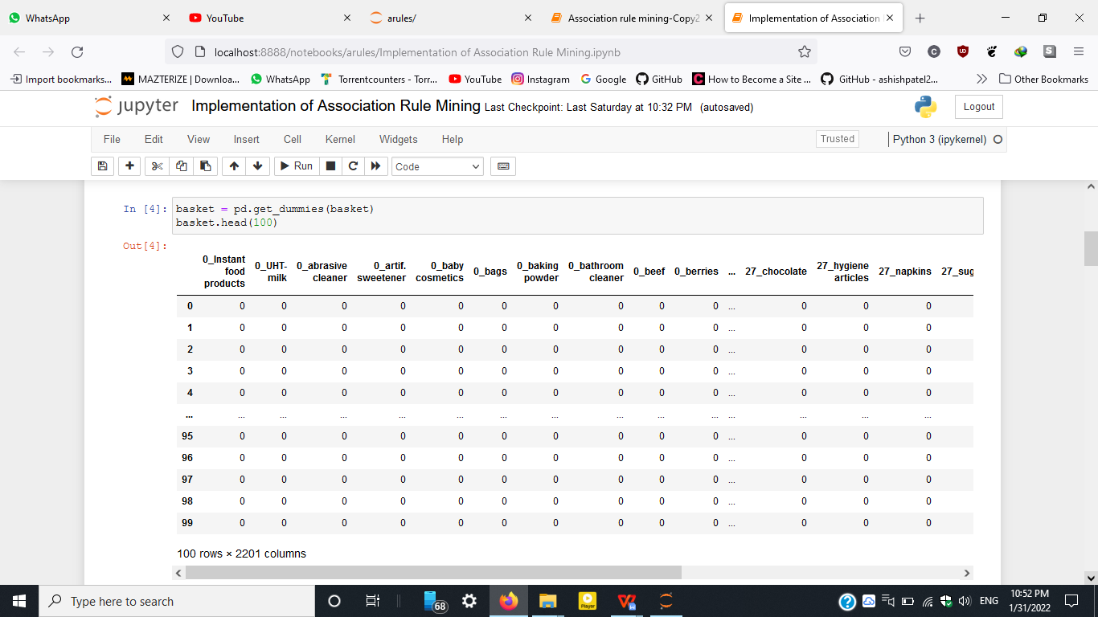

Slide 16
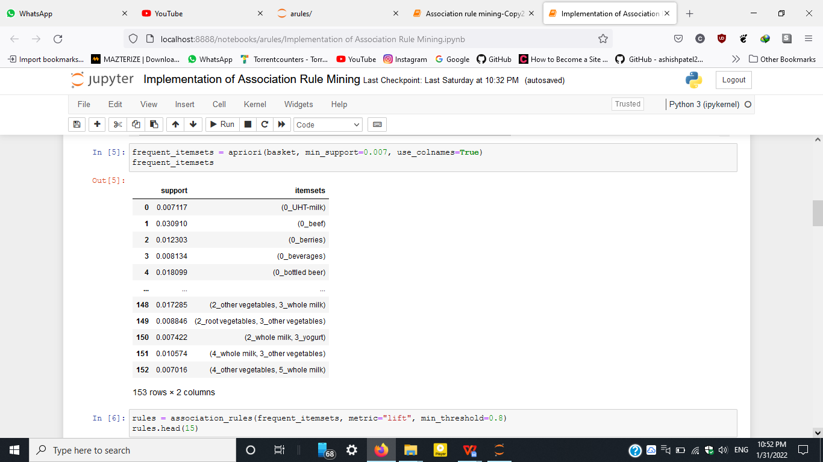

Slide 17
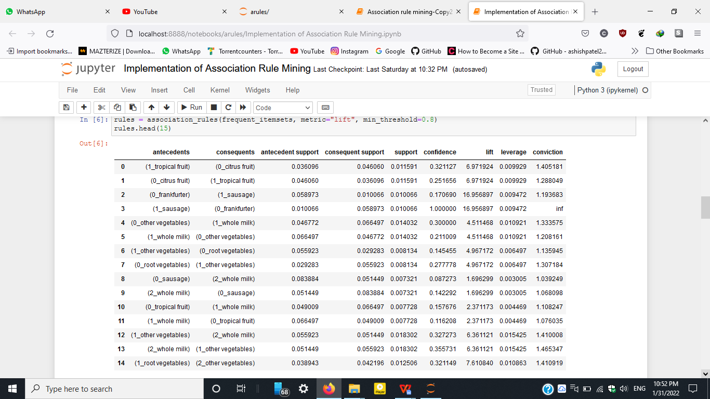

Slide 18
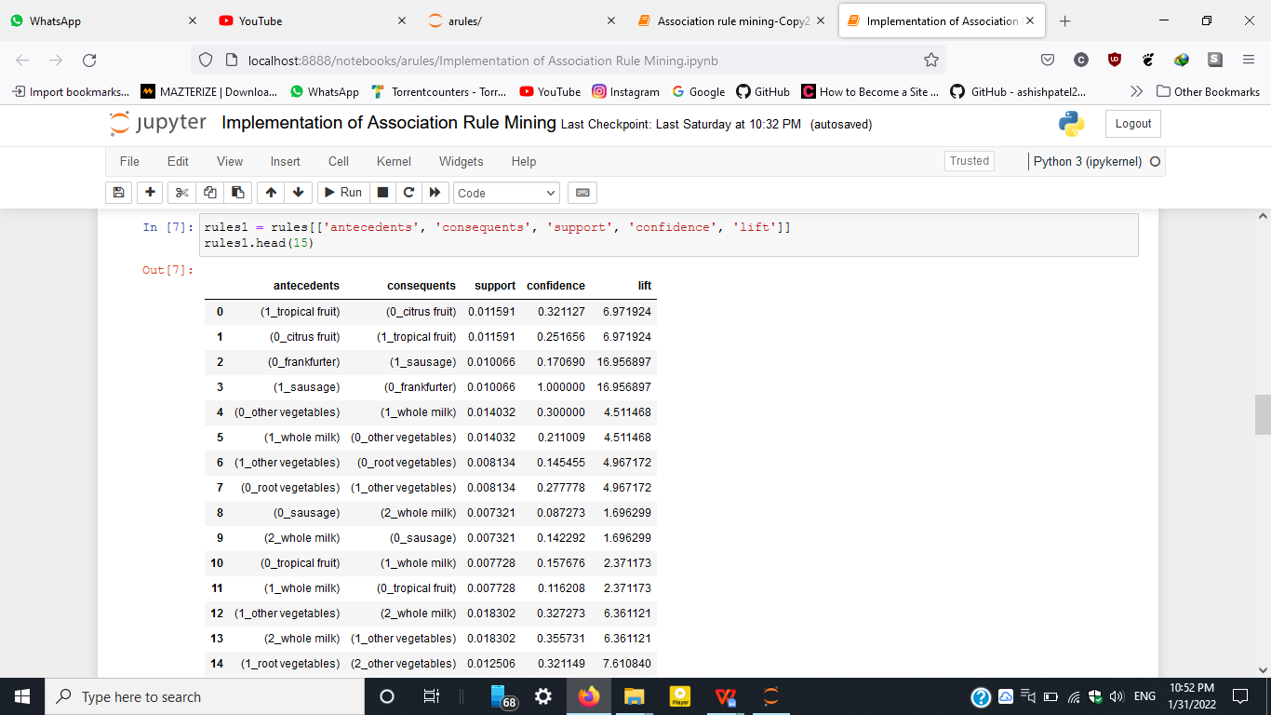

Slide 19
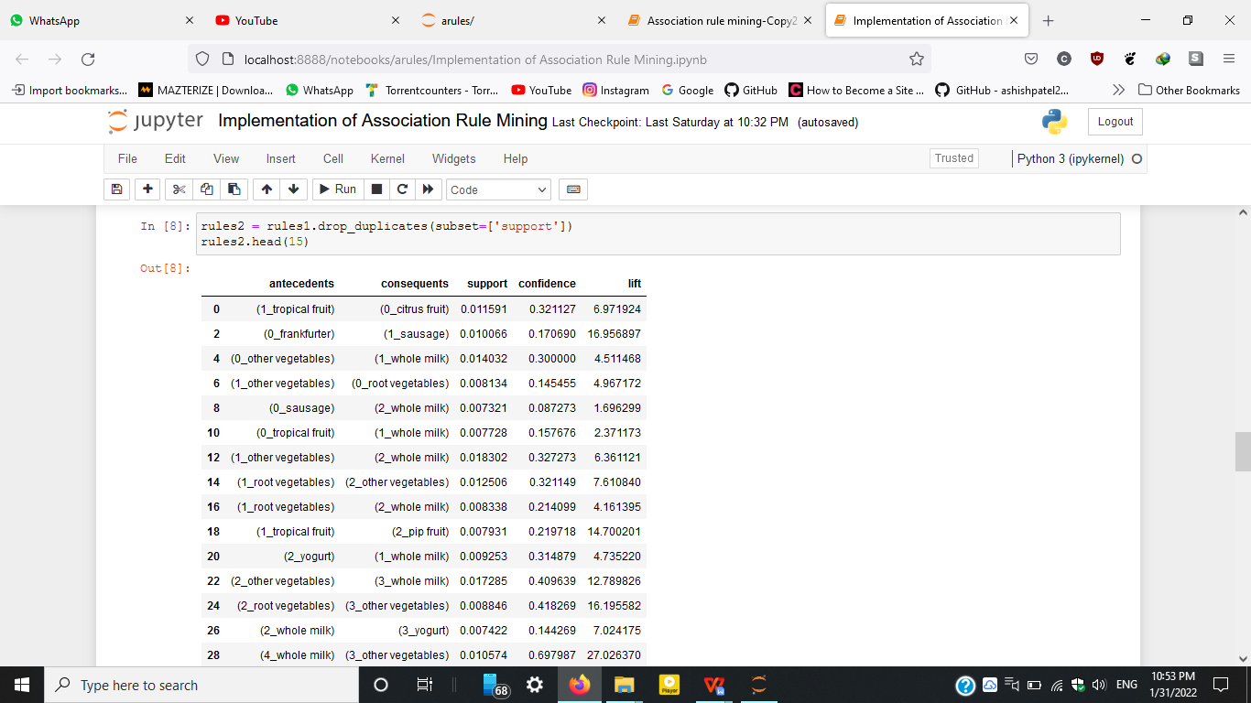

Slide 20
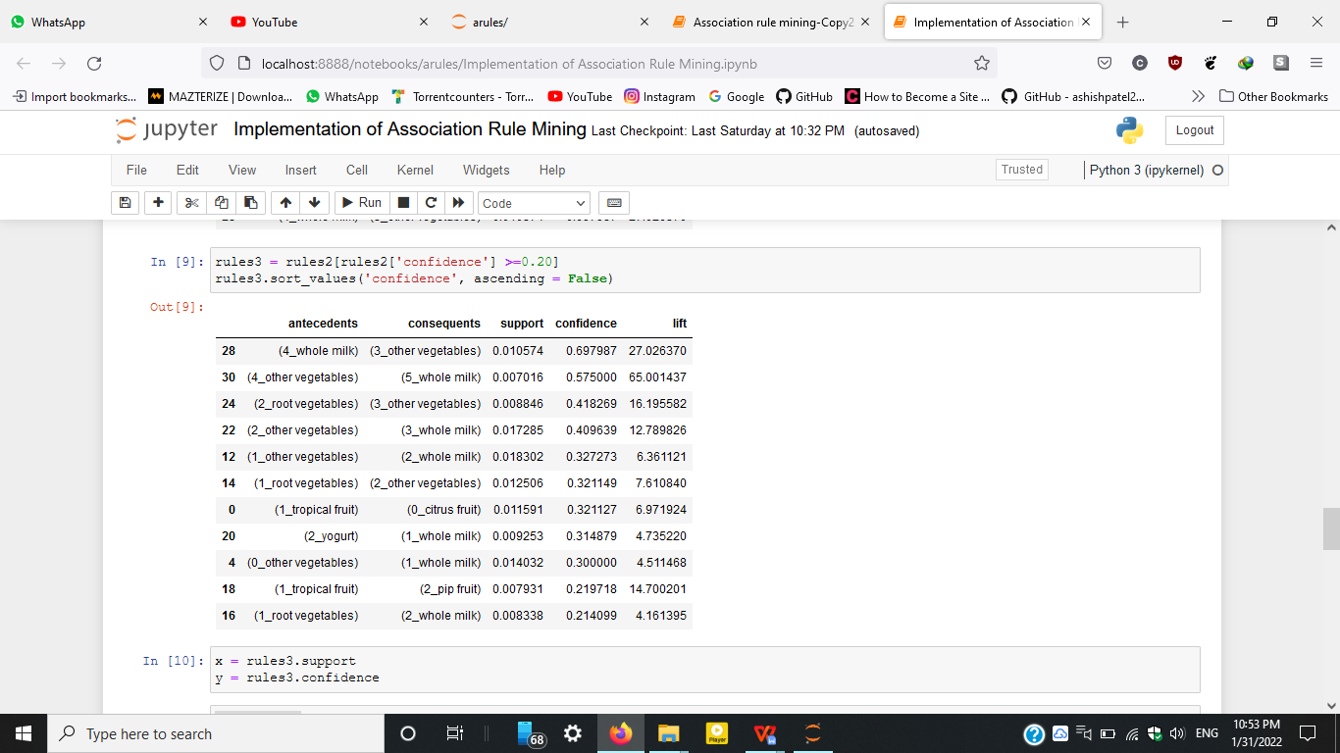

Slide 21
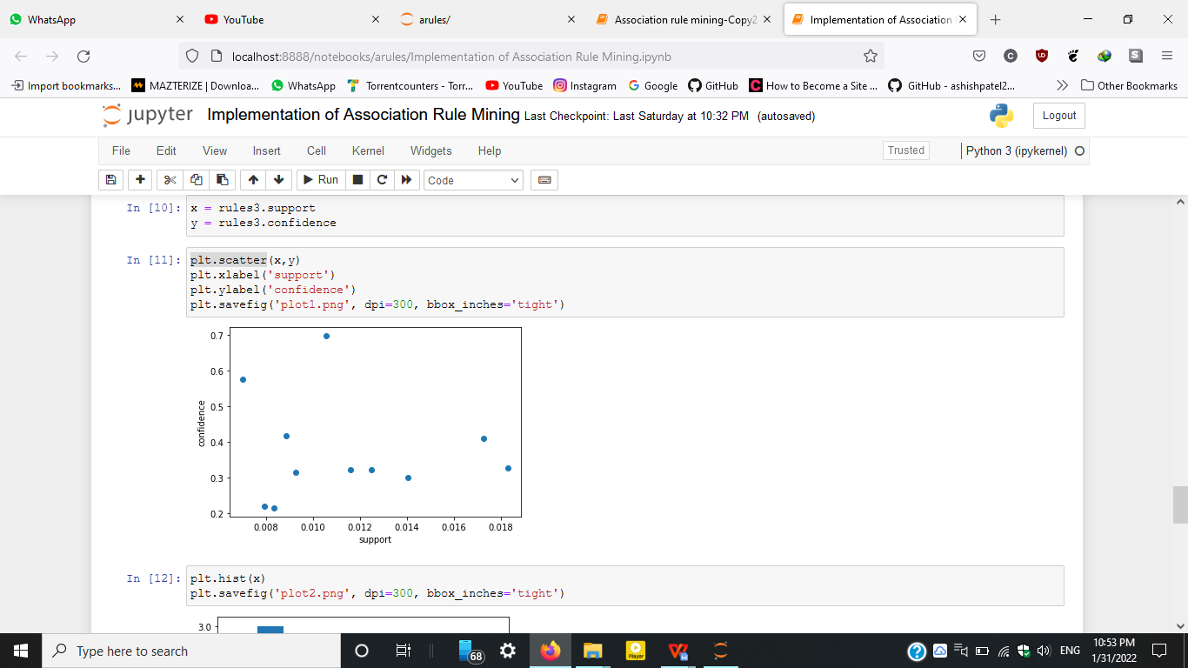

Slide 22
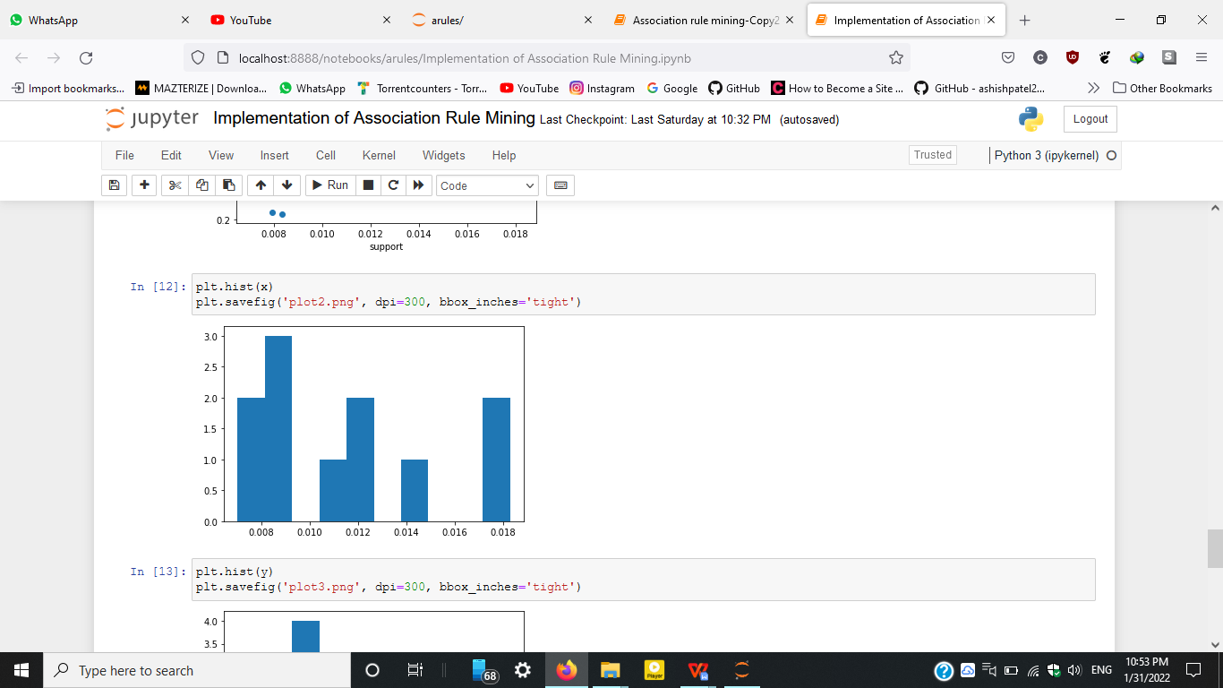

Slide 23
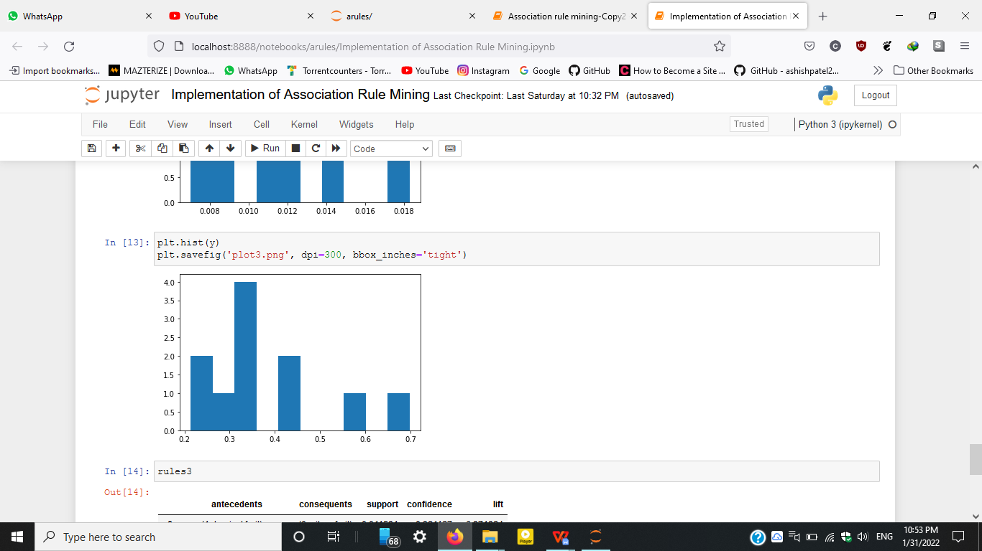

Slide 24
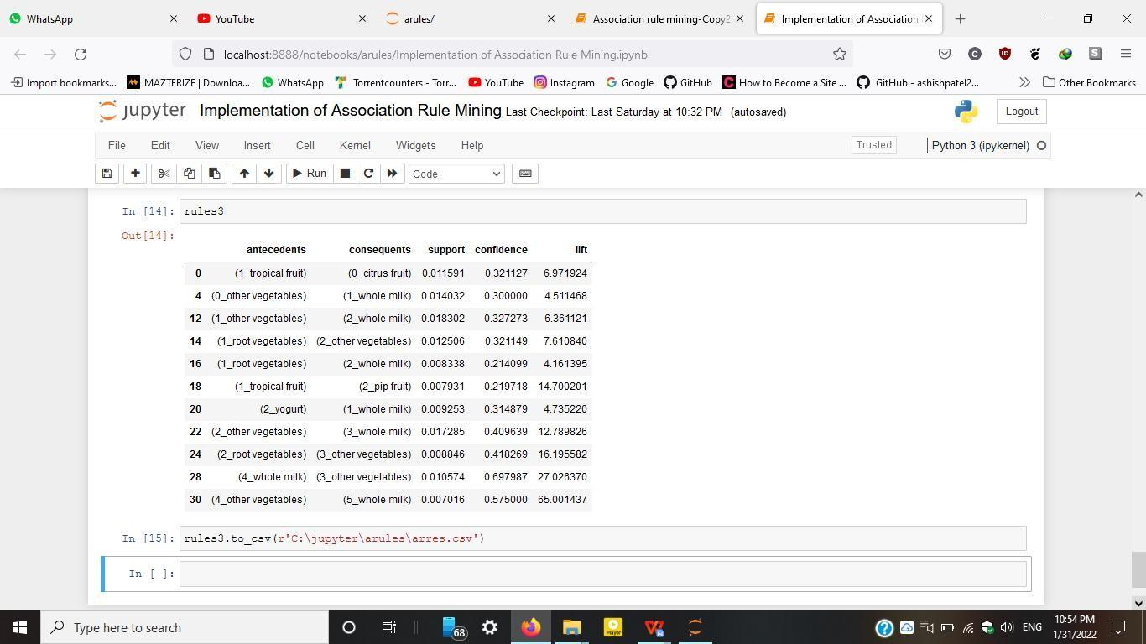

Slide 25
CONCLUSION
Association Rule Mining greatly helped us to develop our knowledge on Python.
Association rule mining can be greatly useful for businesses willing to increase their sales whether it's a small retail store or e-commerce website.

Slide 26
Thank You

